Slide 1
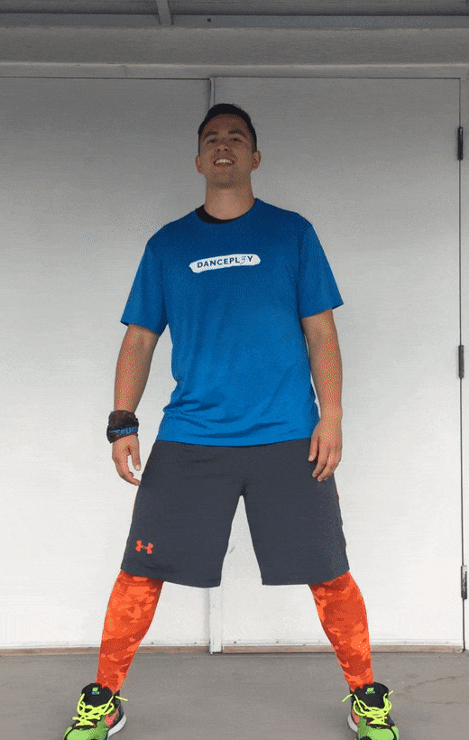
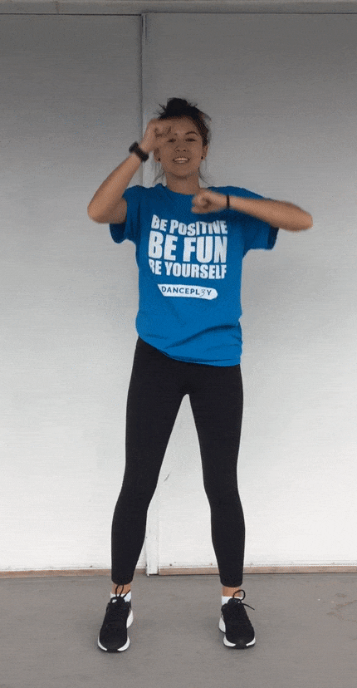
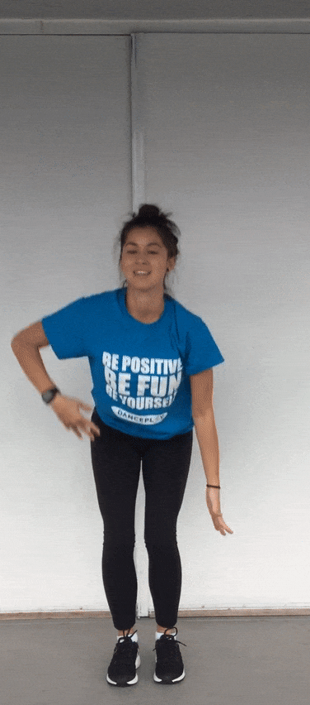
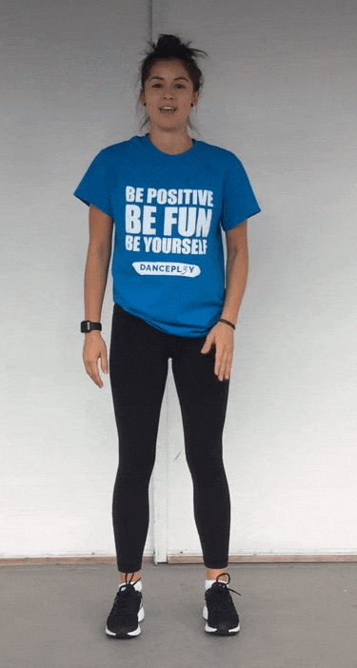
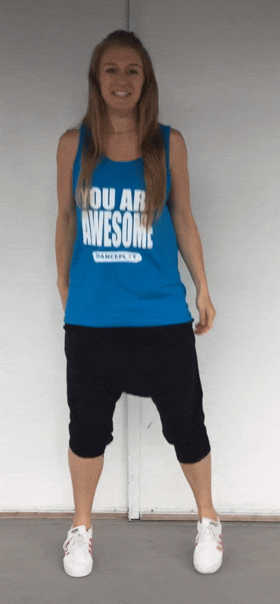
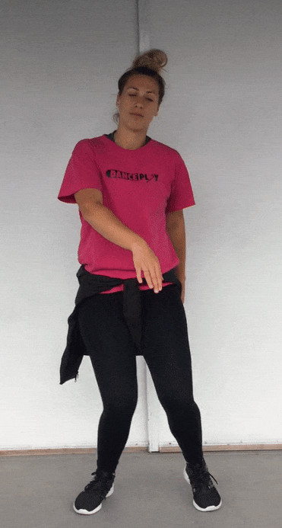
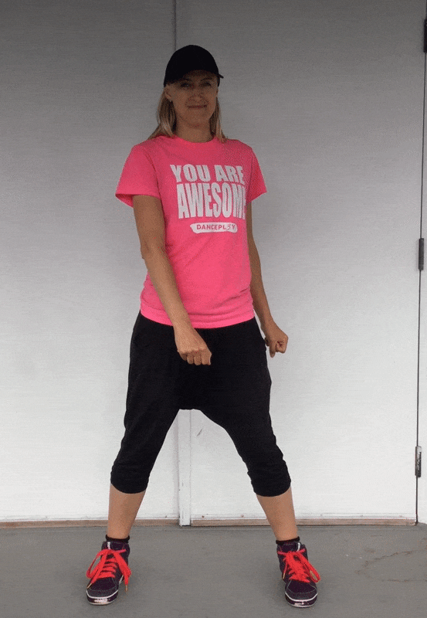
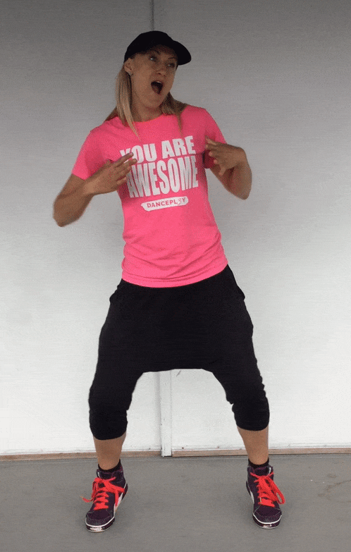
A/M/Y
C/O
E/Q
F/R
B/N/Z
D/P
Brush Your Shoulders
Punch Punch
Up Up Down Down
Used Car Windsock Guy
Hop Scotch
Roll and Clap
Freeze
G/S
H/T
J/V
K/W
L/X
I/U
Funky Chicken
Disco Point
Knee Wobble
Party and Throw
Floss
Balance

